Slide 1
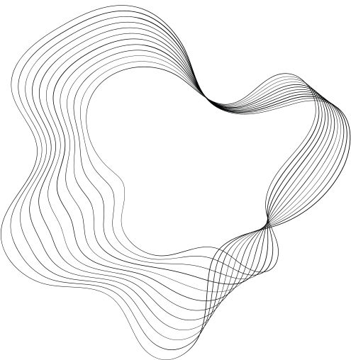

HANDWRITTEN DIGIT RECGNITION USING GAN
NAAN MUTHALAVAN PROJECT
PRESENTED BY: SIVASUBRAMANIYAN S(71772118502)
INFORMATION TECHNOLOGY
GOVERNMENT COLLEGE OF TECHNOLOGY
COIMBATORE,

Slide 2
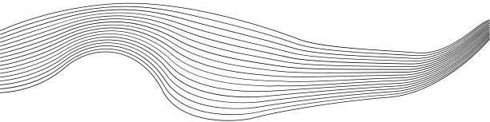

OUTLINE
01
PROBLEM STATEMENT
02
PROPOSED SYSTEM/SOLUTION
03
SYSTEM DEVELOPMENT APPROACH
04
ALGORITHM & DEPLOYMENT
05
CONCLUCION

Slide 3
PROBLEM STATEMENT
Here's a concise problem statement for the project involving the use of a Generative Adversarial Network (GAN) to generate images of handwritten digits.
Problem Statement
Develop a Generative Adversarial Network (GAN) to generate realistic images of handwritten digits to augment existing datasets, thereby enhancing the training process and performance of models for digit recognition tasks.

Slide 4
Proposed Solution
1. Develop a Generative Adversarial Network (GAN)
Generator: Creates new images that mimic handwritten digits from a random noise input using neural networks.
Discriminator: Acts as a classifier to differentiate between real images from the MNIST dataset and fake images produced by the generator.
2. Training Process:
Adversarial Training: The generator and discriminator are trained together, where the generator learns to make more realistic images to fool the discriminator, and the discriminator learns to better identify fake image.

Slide 5
Proposed Solution
3. Data Augmentation with Generated Images:
After training, use the generator to create new digit images that are added to the original MNIST dataset to enhance its diversity and volume.
4. Integration and Testing:
Use the augmented dataset to train a digit recognition model and assess its performance, especially on test data.
5. Quality Control and Evaluation:
Qualitative Assessments
Quantitative Metrics

Slide 6
System Approach
Hardware Requirements:
Processor: A modern multi-core processor (e.g., Intel i7 or AMD Ryzen 7) to handle complex computations efficiently.
Graphics Processing Unit (GPU): A high-performance GPU with CUDA support (e.g., NVIDIA GTX 1080 or higher) .
RAM: Minimum of 16 GB RAM, but 32 GB or more is recommended for handling large datasets and simultaneous processing tasks.
Storage: At least 1 TB of storage space to accommodate large datasets, training models, logs, and system backups.

Slide 7
Algorithm & Deployment
1.Generative Adversarial Network (GAN) Setup:
Generator: The generator network starts with a random noise vector and uses a sequence of transposed convolutional layers (or fully connected layers for simplicity) to produce a 28x28 pixel image that resembles handwritten digits.
Discriminator: The discriminator network takes an image as input (either a real image from the dataset or a fake image from the generator) and uses convolutional layers (or fully connected layers) to output a probability indicating whether the image is real or generated.

Slide 8
Algorithm & Deployment
1.Training Process:
Simultaneous Training: The generator and discriminator are trained simultaneously.
Loss Functions: The discriminator uses binary cross-entropy loss to improve its accuracy in classification.
2.Evaluation and Adjustment:
Image Quality Check: Generate images to visually assess their quality and adjust model parameters or if necessary.
Metrics: Distance to quantitatively evaluate the realism and diversity of generated images.

Slide 9
Conclusion
In conclusion, the project to develop a Generative Adversarial Network (GAN) for generating images of handwritten digits showcases the practical application of advanced AI technology to enhance machine learning models. By successfully training a GAN to produce realistic digit images, this system provides a valuable tool for augmenting datasets, thereby improving the accuracy and robustness of digit recognition technologies.l): For data manipulation and analysis, if necessary.

